Slide 1


CODEX MASTERCLASS

Slide 2
AGENT SKILLS

Slide 3

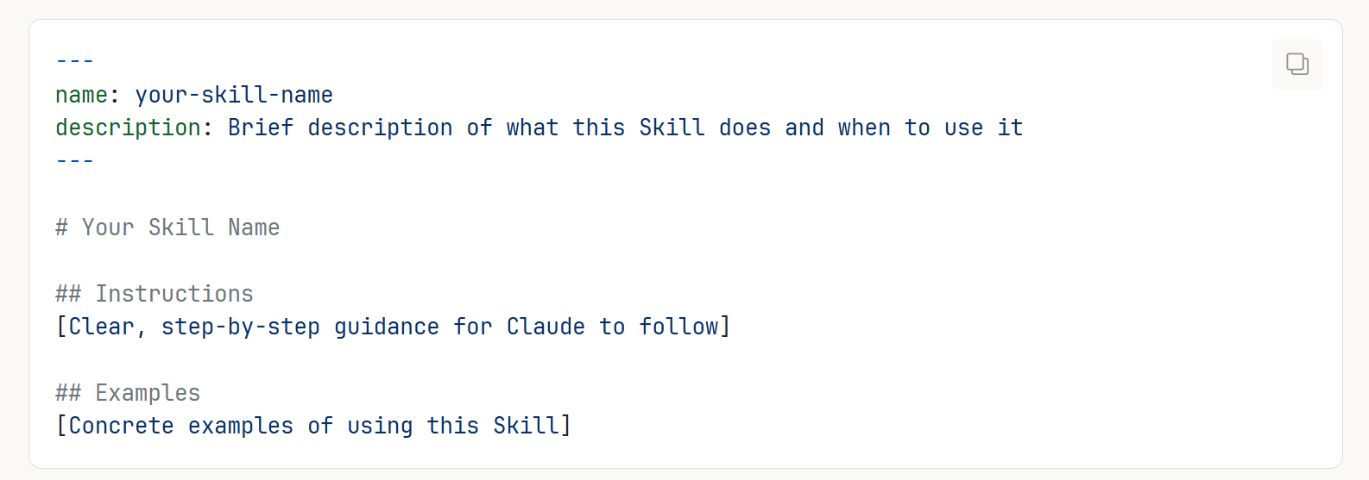
What is an agent skill?
Skills extend Codex capabilities by giving it access to specialized knowledge and workflows. Create once, use everywhere.
Codex loads skills dynamically to improve performance on specialized tasks.
Every Skill requires a SKILL.md file.
Note that on the top of each SKILL.md file, there is metadata that describes what the skill does which includes name and description.
© All rights reserved for Dr. Ryan Ahmed @Stemplicity Inc.

Slide 4
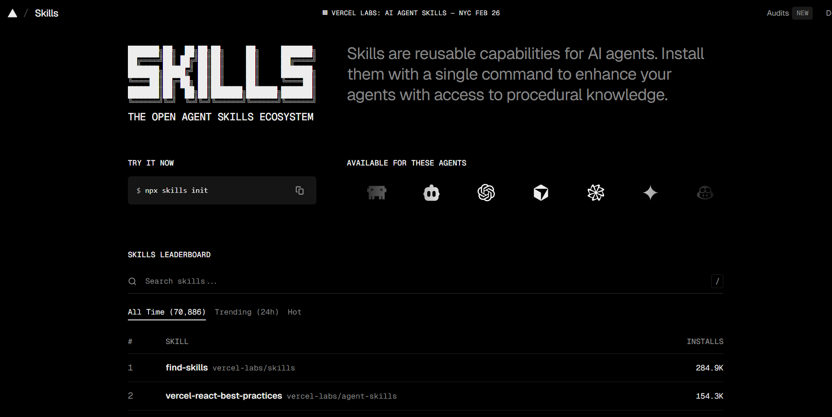
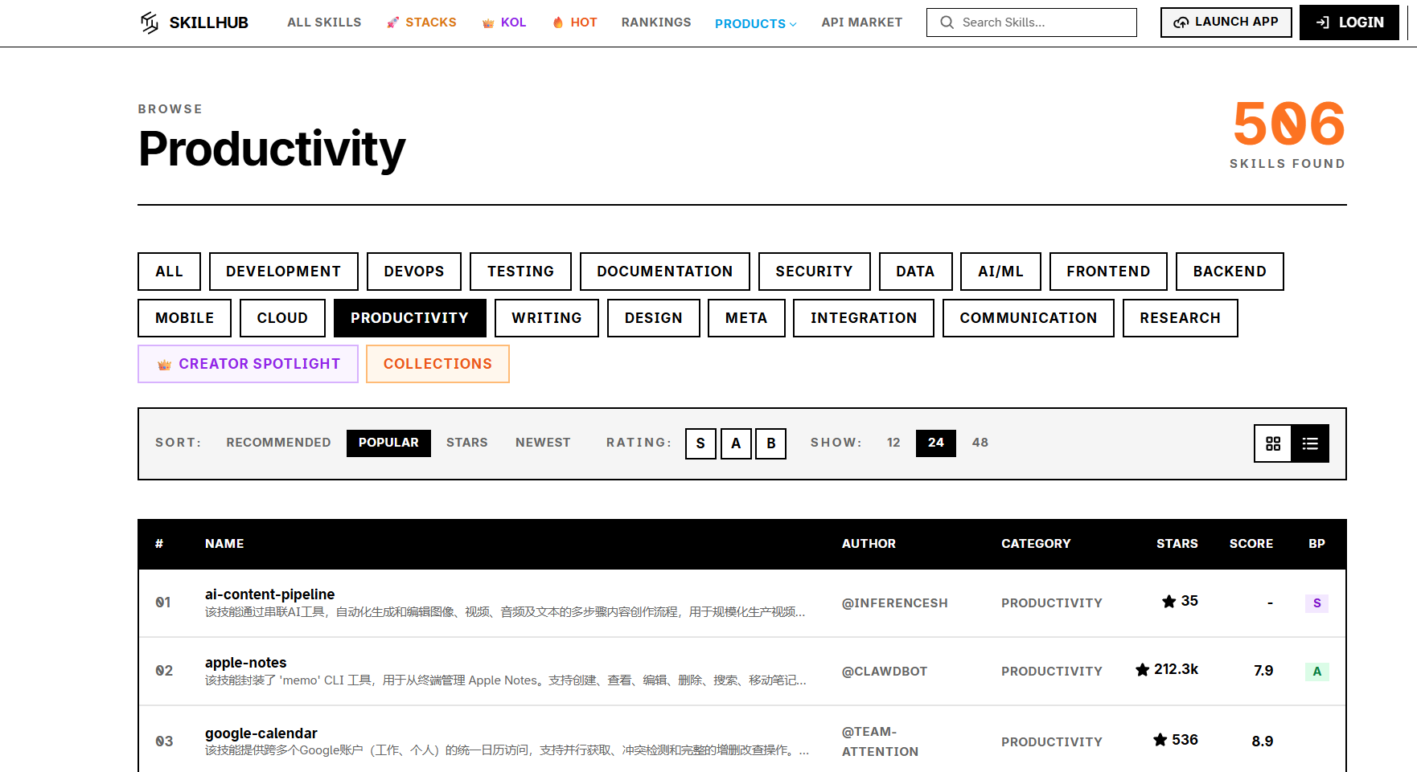
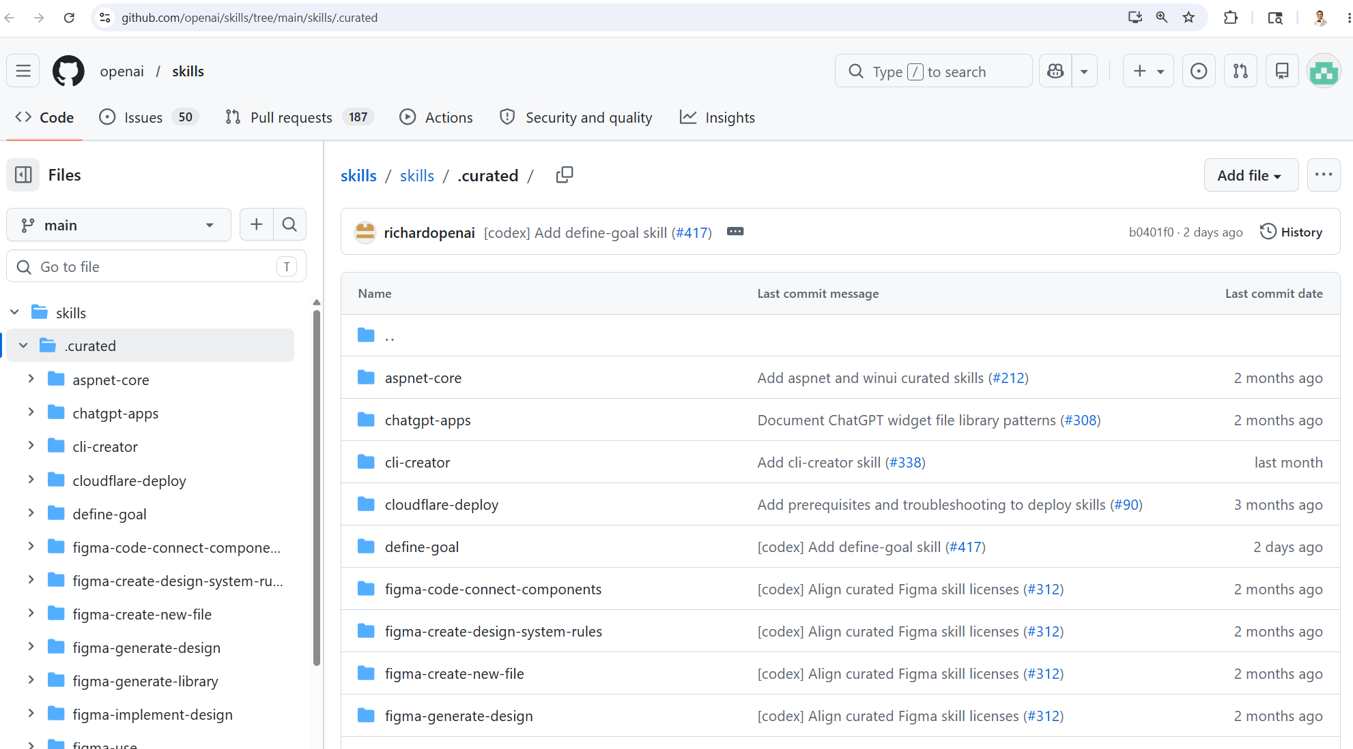
Skills Sources
https://skills.sh/
https://www.skillhub.club/
© All rights reserved for Dr. Ryan Ahmed @Stemplicity Inc.
https://github.com/openai/skills/tree/main/skills/.curated

Slide 5



Skills Sources
Built-in Skills
Custom Skills
Partner Skills
Create your own
Upload via Customize
Tailored to your needs
© All rights reserved for Dr. Ryan Ahmed @Stemplicity Inc.
Excel spreadsheets
Word documents
PowerPoint decks
PDF processing
Notion, Figma, Atlassian
Work with MCP connectors
Professionally built
Skills Directory

Slide 6
PRACTICAL PROJECT: CODEX AGENT SKILLS

Slide 7
Project: Agents Skill
The Problem: Codex is powerful but generic out of the box
Skills add specialized capabilities (presentations, Excel, PDF, and more)
WITHOUT SKILL (V1)
Bullet-heavy slides
Default fonts, no hierarchy
Charts dumped without context
Every slide looks the same
Walls of text
WITH SKILL (V2)
One insight per slide
Big hero numbers, proper layouts
Consistent color palette
Charts with annotations
Designed infographic feel
© All rights reserved for Dr. Ryan Ahmed @Stemplicity Inc.

Slide 8
The ppt-visual Skill
GitHub link: https://github.com/claude-office-skills/skills/blob/main/ppt-visual/
What It Teaches Codex
One idea per slide, visual hierarchy
Proper color palettes and typography pairings
Big hero numbers, split layouts
Charts with annotations and context
Whitespace as a design element
Professional design principles baked in
How to Install
1. Download SKILL.md
from GitHub repo
2. Upload into Codex
Use the Create Skill-installer skill to download the ppt-visual skill
3. Verify
Skill appears in the list
© All rights reserved for Dr. Ryan Ahmed @Stemplicity Inc.

Slide 9
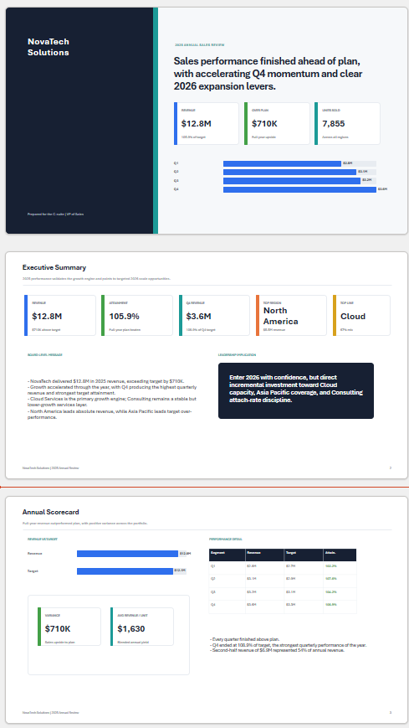
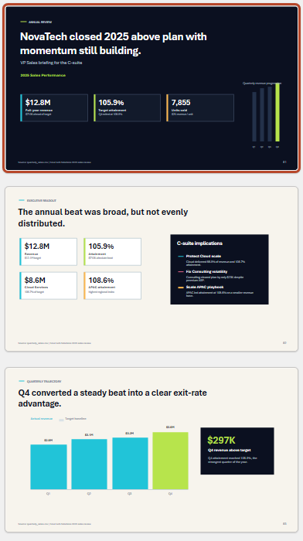
Before and After
© All rights reserved for Dr. Ryan Ahmed @Stemplicity Inc.

Slide 10
Thank you!

